Slide 1

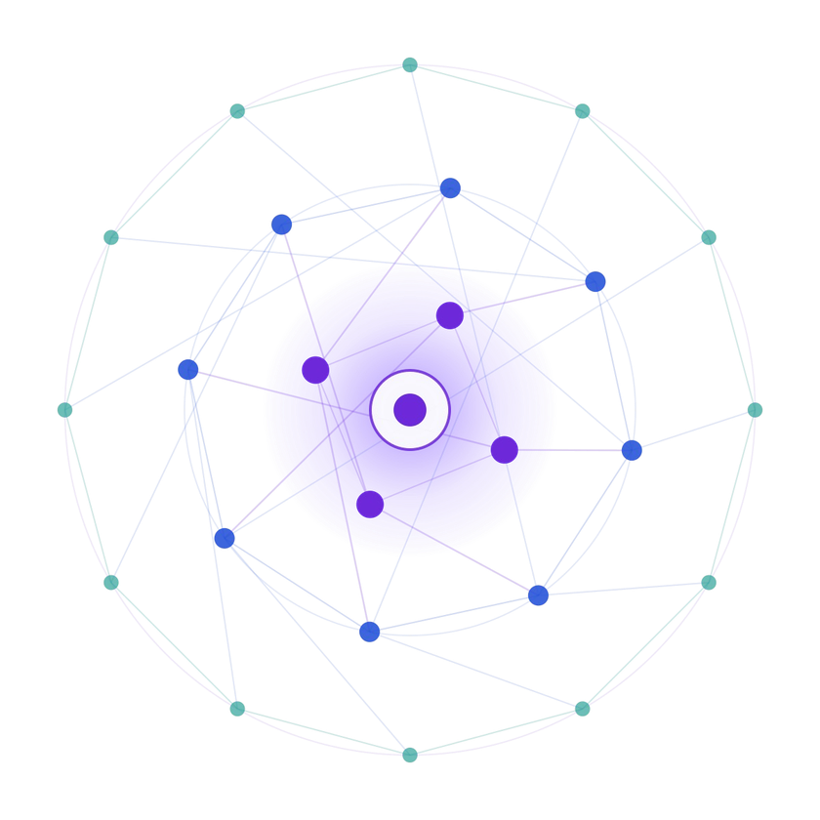
SAMSUNG PRISM
Generative AI Hackathon
3rd Edition 2026 – 27
  Theme ID - 04 (Streaming Live RAG)
  Team Name - Live RAGrets
  College Name - SRM Institute of Science and Technology, Kattankulathur
  Member 1 - R Rakavi, rr2494@srmist.edu.in
  Member 2 - K Divya Dharshini, kd3771@srmist.edu.in
  Member 3 - Anujaa C, ac9294@srmist.edu.in
  Member 4 - Lacsita K A, lk7225@srmist.edu.in
  GitHub - github.com/divyadharshini165/streaming-live-rag

Slide 2

Theme
The Real Problem
Normal RAG is turn-based: the user finishes a clean typed question, then the system searches, then answers. Live voice conversation is different: words arrive in small timestamped chunks, several questions hide in one breath, and people add details after they already got an answer.
1. Latency
The system waits for the speaker to stop, adding seconds of dead silence before search even starts.
Fix: Retrieval Controller fires early.
2. Multi-intent
One sentence can hold three questions: venue capacity, cancellation terms, catering.
Fix: Decomposer splits and searches in parallel.
3. Late details
'Actually the trip was international and booked after travel' should update the answer, not restart it.
Fix: versioned answers v1 to v2.
4. No-search turns
'Repeat that in two bullets' needs a reformat, not a new search.
Fix: controller suppresses retrieval.
Grounding rule: every fact carries a [Doc_ID §section] citation; if the corpus lacks the answer the system says so in an explicit uncertainty field. No web search, no LLM guesses.
What we must build
A Streaming Live RAG Engine: Controller, Multi-Intent Decomposer, Hybrid Retrieval + Fusion, Session-Aware Synthesis and Telemetry, judged on gates G1-G6 (one-command run, early retrieval, multi-intent, grounding, refinement, logging) using only the corpus provided.

Slide 3


Existing Solutions & Gaps
Existing approach | How it works | Gap for live speech
Classic turn-based RAG | Waits for the full question, one search, one answer | Adds full silence latency; cannot split multi-part sentences; restarts on follow-ups
Naive streaming RAG | Searches on every incoming chunk | Wasted searches on unclear fragments; noisy, costly; no answer memory
Single-query voice assistants | Treat the utterance as one query string | Compound questions retrieve one blurred result set; partial answers
Heavy multi-agent pipelines | Many LLM agents plan, retrieve, critique | High token cost and latency; hard to audit; explicitly not rewarded by the guide
Ungrounded LLM answers | Model answers from its own memory | Hallucinated facts, no citations, fails the grounding gate
Our gap-closing idea
Decide when to search, not just what to search: Wait / Retrieve / Suppress per chunk.
Cheap by design
Rule-based controller, one optional LLM call, local embeddings. Every component justifies its cost.
Auditable
Every event, query, citation, answer version and token cost is logged as JSONL.

Slide 4




Our Solutions & Architecture Diagram
INPUT: transcript chunks with timestamps (0.0s, 0.8s, 1.6s...), from real ASR or the built-in simulator
1 Retrieval Controller
  Per chunk: WAIT, RETRIEVE or SUPPRESS
  Needs clear topic + entity to fire early
  Skips 'repeat', 'shorten', small talk
  Detects late-detail turns
2 Multi-Intent Decomposer
  Splits one sentence into sub-queries
  LLM JSON output, rule fallback
  Sub-queries run in parallel
  Merges late detail into prior intent
3 Hybrid Retrieval + Fusion
  BM25 sparse + bge-small dense (FAISS)
  Reciprocal Rank Fusion (RRF)
  Rerank and de-duplicate
  Chunk IDs like Doc_08 §2
4 Session-Aware Synthesis
  Answer only from retrieved chunks
  Cite every fact, strip fake IDs
  Uncertainty field if not found
  v1 to v2 with kept/added lineage
OUTPUT: structured JSON - retrieval_events, sub_queries, answer (version), citations, uncertainty
Session state (one session only)
Current answer version, evidence set and sub-queries. No cross-session profiles.
Telemetry (every stage)
Timestamps, decisions, when retrieval fired, queries, citations, versions, tokens, cost.

Slide 5



Demo & Product Walkthrough
Scenario 1: Multi-intent + early retrieval
  Input: 'Plan a customer workshop in Pune for 30 people, need the cancellation policy and catering options.'
  RETRIEVE fires at 4.29s; utterance ends
  8.16s: retrieval 3.87s early
  Sub-queries: venue capacity | cancellation policy | catering
  Answer cites Doc_08 §2, Doc_13 §1 and more
Scenario 2: Late detail refines v1 to v2
  Turn 1: travel reimbursement rule, answered as v1 with citations
  Turn 2: 'The trip was international, booked after travel'
  Only the new part is searched
  Lineage: 3 facts kept, 3 added, 0 dropped
Scenario 3: Suppress and honesty
  'Repeat that in two bullets' gives retrieval calls
  = 0 (reformat only)
  Question not in corpus (parking): 'I could not verify this from the provided documents.'
  uncertainty field explains what is missing
  No fabricated citation ever shown
Run it: docker compose up --build | demo: docker compose exec streaming-rag python -m app.demo --fast --script eval/demo_script.txt
Also available
Swagger UI at localhost:8000/docs, REST + WebSocket streaming, /health reports retrieval_mode = hybrid, JSONL logs per session.

Slide 6




Tools and tech stack used
Language / API
- Python 3.11
- FastAPI + Uvicorn
- REST + WebSocket
Sparse retrieval
- rank_bm25 (BM25Okapi)
- Keyword-exact matching
- Works fully offline
Dense retrieval
- bge-small-en-v1.5
- sentence-transformers
- FAISS index, CPU only
Fusion + rerank
- Reciprocal Rank Fusion
- Rerank + de-duplication
- Configurable via env
LLM
  Any cheap API: Groq / Gemini
  - Only decompose + write answer
  Offline extractive fallback
Packaging
  Dockerfile + docker-compose
  - Pinned requirements.txt
  One command run
Evaluation
  22-session test set
  - Baseline + 3 ablations
  Auto report.md
Testing / logging
  pytest (5 tests)
  - Fake-LLM citation test
  JSONL telemetry
Design principles
Corpus-agnostic: indexes whatever PDF, TXT or MD files sit in data/corpus/, no hardcoded answers or prompts. Cheap: rule-based controller, one LLM call at most per turn. Safe: citations validated against real chunk IDs, hallucinated ones stripped and logged.

Slide 7
Impact & Use case
Enterprise helpdesk
Employees ask policy questions by voice: travel, leave, events.
Answers arrive as they finish speaking.
Contact centres
Agent assist retrieves policy while the customer is still talking, cutting handle time.
Meeting copilots
Live questions get cited answers from internal knowledge bases mid-discussion.
Voice assistants
Multi-part spoken requests are handled in one turn with corrections merged.
3.9s
retrieval started before the utterance ended (demo)
3 in 1
separate intents found in one sentence
0
fabricated citations across the test set
$0
cost in offline extractive mode
Who benefits
Users get faster, trustworthy answers; teams get an auditable, low-cost engine.
Why it scales
Drop in any document folder; swap embedding model or LLM through configuration.

Slide 8



Innovation highlights, results and limitations
Metric (22 sessions) | Target | Ours | Classic RAG
G2 early retrieval | >=80% | 100% | 0%
G3 multi-intent | >=70% | 100% | 0%
G4 grounded citations | >=85% | 100% | 100%
G5 refinement | pass | 100% | 0%
G6 telemetry | 100% | 100% | 100%
Ablation | Result
No decomposition | G3 0%, G5 75%
Sparse only | 100% gates, TTFT 115ms
Dense only | 100% gates, TTFT 175ms
Full hybrid | recall 1.0, TTFT 158ms
Baseline | recall 0.96, TTFT 247ms
Innovation
  Decide when to retrieve, not just what
  Answer versioning with kept/added lineage
  Citation validator strips fake IDs
  Works offline; no heavy agents
Limitations
  Test set self-written, so scores are optimistic
  Topic switch after an answer is treated as refinement
  Typos and filler words not normalised
  Rule-based controller tuned on English
Honest note
Hidden judge transcripts may score lower. The full report adds 3 failure cases and 2 ablations against the baseline.

Slide 9




What’s next
Near term
  Topic-switch detector so unrelated turns start a fresh answer
  Typo and filler-word normalisation
  Learned controller vs rule-based ablation
Mid term
  Real ASR input (Whisper streaming)
  Cross-encoder reranker
  Confidence-based early answer drafting
Long term
  Multilingual voice (Indian languages)
  Speculative prefetch of likely follow-ups
  Per-tenant corpora with access control
Deliverables
  Architecture brief (<=6 pages)
  Evaluation report with 3 failures
  Demo video (<=5 min)
Goal
Move from a validated prototype to a production voice-RAG component that stays cheap, grounded and auditable as corpora and languages grow.

Slide 10
Brownie points slide( differentiation)
Explicit uncertainty
Says it cannot verify instead of guessing
Citation firewall
Fabricated [Doc_99 §9] tags removed and logged
Answer lineage
Each version lists kept, added, dropped facts
Suppression logic
Reformat and chit-chat cost zero retrieval
Offline mode
Extractive answers, $0, no API key needed
Corpus-agnostic
Any PDF/TXT/MD folder indexed automatically
Full observability
JSONL events plus benchmark report
Ablation-backed
Baseline and 3 ablations show each part matters
Differentiator in one line: a live engine that knows when to search, what to search, and when to admit it does not know.

Slide 11
Checklist- Updated on Public GitHub
Item | Done (Y/N) | Notes
Working prototype in public GitHub repo | Y | github.com/divyadharshini165/streaming-live-rag
README with reproducible setup | Y | Docker one-command run verified, hybrid mode
Release tag PRISM_GENAI_HACKATHON_Y2026 | Y | Pushed on final commit
Tests and benchmark (G1-G6) | Y | 5 pytest passing; 22-session eval
Presentation (PPT + PDF) | Y | Template followed
Demo video (<=5 min) | N | To be recorded, link to be added
Architecture brief (<=6 pages) | N | In progress
Evaluation report (3 failures, 2 ablations) | N | Data ready in eval/results/report.md
AI disclosure document | N | Fill Samsung disclosure form
Team: Live RAGrets, SRM Institute of Science and Technology, Kattankulathur. Members 2-4: <name, email> to be filled.

Slide 12
Thank you
Organised by the Language AI Team and the PRISM Team, Samsung R&D Institute India

